Slide 1
MOVIE RECOMMENDATIONS SYSTEM
Team 1:
Garvit Tanwar
Shreyash Pagrut
Shantanu K Jaipurkar
Vishal Adhav

Slide 2
INDEX
INTRODUCTION
DATA ACQUISTION
VISULIZATION
EXEXPLORING DATA AND FEATURE
MOVIE RECOMMENDATIONS
HOW THE SYSTEM WORKS?
GUI INTRACTION
THANKS

Slide 3
INTRODUCTION
In the vast landscape of entertainment, the need for personalized and accurate movie recommendations has become crucial. Users are often overwhelmed with choices, making it challenging to discover movies tailored to their preferences. Movie Recommendation Systems aim to address this challenge by leveraging advanced algorithms to suggest movies based on user behavior, preferences, and historical data.

Slide 4
Data Acquisition:
We will first import all the required libraries
import pandas as pd
from sklearn.feature_extraction.text import CountVectorizer
from sklearn.metrics.pairwise import cosine_similarity
from sklearn.cluster import KMeans
from tkinter import messagebox, ttk
from tkinter import *
from tkinter.scrolledtext import ScrolledText
import matplotlib.pyplot as plt
from matplotlib.backends.backend_tkagg import FigureCanvasTkAgg
import seaborn as sns
import ipywidgets as widgets
from IPython.display import display
Now we will be importing the data from the csv file :
movie_data = pd.read_csv("movie_data.csv")
movie_data.head() # this command will show top 5 entries
movie_data.info() # This method prints information of the dataframe including index dtype, column dtype, non null values
movie_data.isnull().sum() # it is used to count the number of missing values in each column of dartaframe , the .sum() the Boolean values along values along each column , treating True as 1 and False as 0

Slide 5
*movie_data.isnull() #Checks for missing null values in Daaframe and resulting DF has same shape as our sample DF where each Boolean value indicates if the respective element in DF is Null
# Handling missing values in specified features
*features = ['director_name', 'duration', 'actor_2_name', 'genres', 'actor_1_name’]
*for feature in features:
* movie_data[feature] = movie_data[feature].fillna(‘’)
*movie_data.select_dtypes(include='object').nunique() # Purpose : Checking unique values in each column
*plt.figure(figsize=(10,5)) # Here we are plotting graphs for genres
*movie_data['genres'].value_counts().head(30).plot(kind='bar’)
*plt.show()
Now we will fill NAN values with default value , which user can decide. Then we will convert title year column to int64 because in DF it was float 64
Then we will plot the Bar Chart

Slide 6
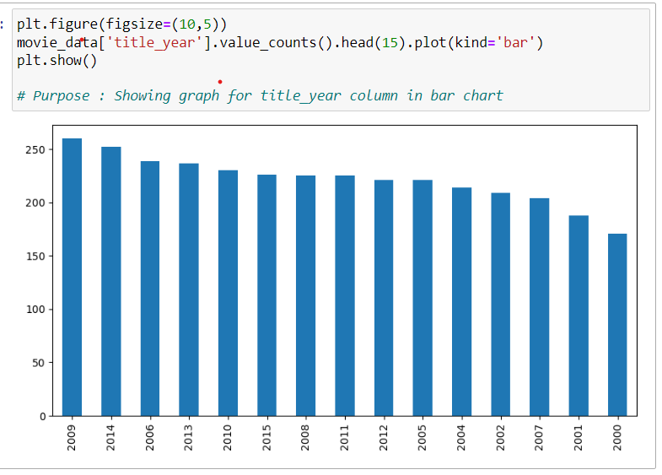

Now we will Extract MIN MAX values for imdb score, duration and num_voted_user
Next we will display the results

Slide 7
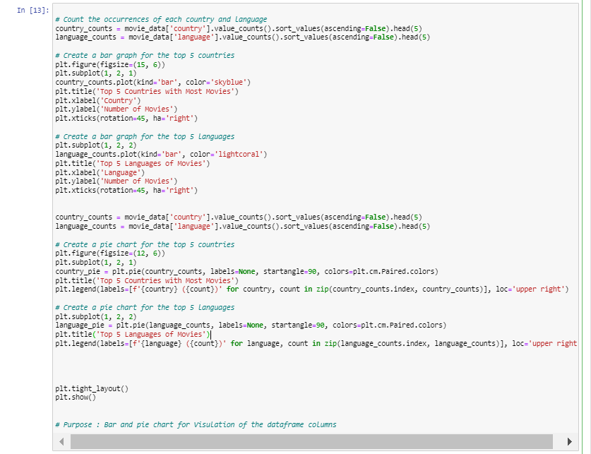
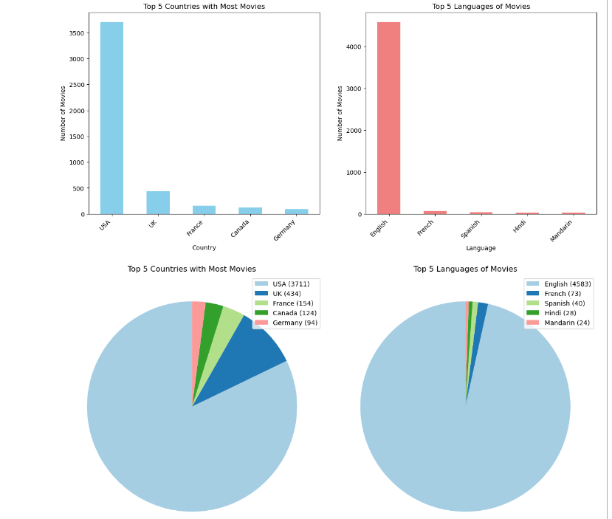
Here , We are preparing a bar and pie chart for the count of movies :
Country Wise
Language Wise

Slide 8
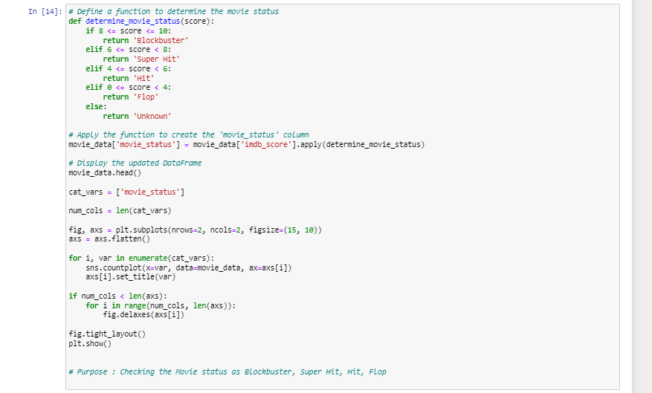
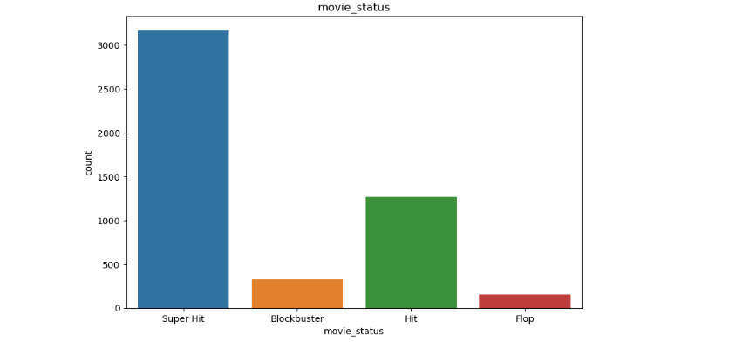
Here we are creating a new column name “movie_status” using below logic:
if 8 <= score <= 10:
return 'Blockbuster'
elif 6 <= score < 8:
return 'Super Hit'
elif 4 <= score < 6:
return 'Hit'
elif 0 <= score < 4:
return 'Flop'
Then we are showing it in a subplot.

Slide 9
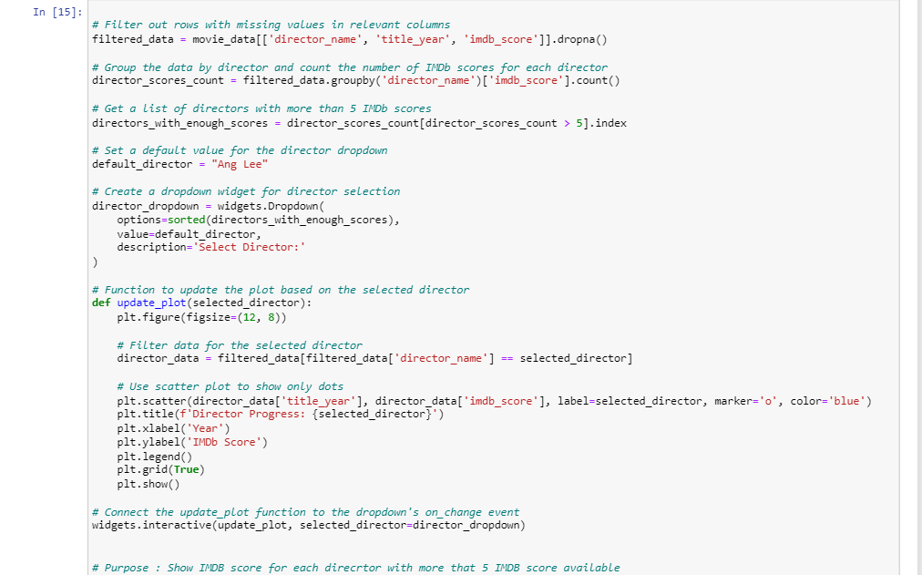
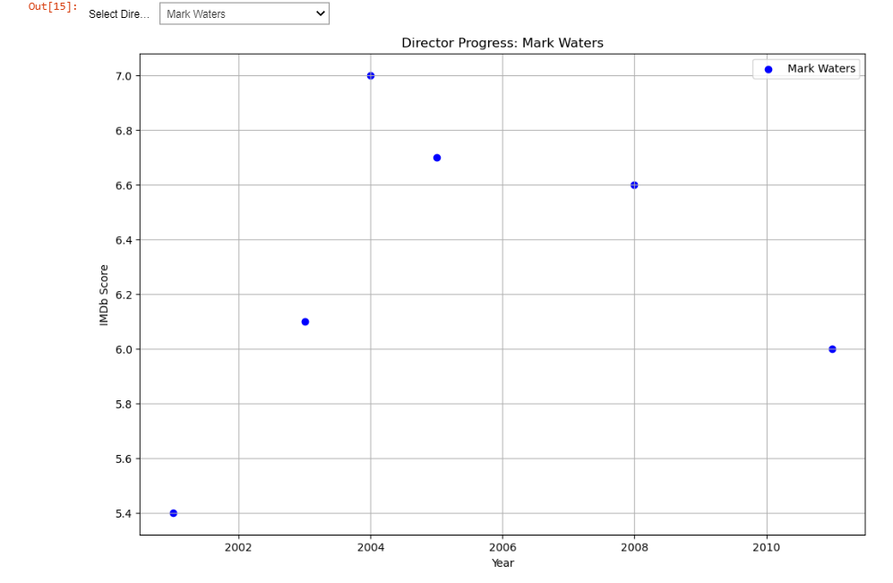
Here we used the Ipywidgets library and the display function from the IPython. display module. This combination is commonly used in Jupyter Notebooks or IPython environments to create interactive widgets and display them within the notebook interface.

Slide 10

EXPLORING DATA AND FEATURE EXTRACTION
INTRODUCTION:
PURPOSE OF THE CODE: THIS CODE SEGMENT IS DESIGNED TO EXPLORE AND EXTRACT ESSENTIAL FEATURES FROM A MOVIE DATASET. THE FUNCTION COMBINE_MOVIE_FEATURES SYNTHESIZES KEY INFORMATION SUCH AS DIRECTOR, DURATION, ACTORS, AND GENRES INTO A UNIFIED STRING. THE PRIMARY GOAL IS TO FACILITATE NATURAL LANGUAGE PROCESSING (NLP) TASKS, ENABLING THE CONVERSION OF MOVIE DATA INTO A FORMAT SUITABLE FOR MACHINE LEARNING ALGORITHMS.
FEATURE EXTRACTION:
EXTRACTING KEY MOVIE FEATURES FROM DATAFRAME.
FEATURES INCLUDE DIRECTOR, DURATION, ACTORS, AND GENRES
CONCATENATING FEATURES INTO A SINGLE STRING
USE CASE:
NATURAL LANGUAGE PROCESSING (NLP) TASKS
TEXT VECTORIZATION FOR MACHINE LEARNING ALGORITHMS

Slide 11
MOVIE RECOMMENDATIONS
Introduction:
Purpose of the Code: This code focuses on providing movie recommendations based on cosine similarity and K-Means clustering. The function get_movie_list combines movie features, computes cosine similarity, and applies clustering to group similar movies. The outcome is a list of recommended movies with their corresponding cosine similarity percentages.
Algorithm Steps:
Compute cosine similarity
Apply K-Means clustering with 5 clusters
Retrieve movie index using get_index_from_movie_title
Select movies from the same cluster
Sort movies by cosine similarity
Output:
List of recommended movies and their cosine similarity percentages

Slide 12
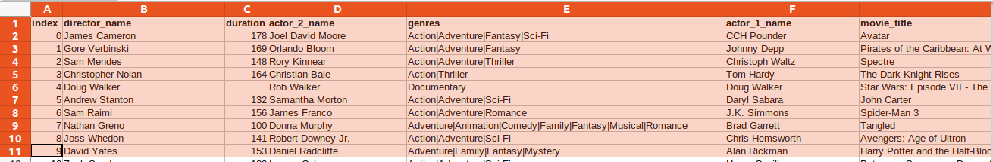
How recommendation works in this system?
Feature Representation:
features are : [director_name, duration, actor_2_name, genres, and actor_1_name]
Dataset :
These features are combined into a single string using the combine_movie_features function.
For Example:
James Cameron 178 Joel David Moore Action|Adventure|Fantasy|Sci-Fi CCH Pounder

Slide 13
How recommendation works in this system?
Count Vectorization:
convert the combined features into a numerical representation.
This creates a matrix where each row represents a movie, and each column represents a unique word or token.
For example:
| James | Cameron | 178 | Joel | David | Moore | Action | Adventure | Fantasy | Sci-Fi | CCH | Pounder |
| 1 | 1 | 1 | 1 | 1 | 1 | 1 | 1 | 1 | 1 | 1 | 1 |
Cosine Similarity Calculation:
For two movies A and B, the cosine similarity is calculated as follows:
Cosine Similarity (A, B) = (A • B) / (||A|| * ||B||)
Let's consider two movies, Movie A and Movie B, represented by their count vectors:
Movie A: [1, 1, 1, 0, 0, 0, 1, 1, 1, 0, 0, 0]
Movie B: [0, 1, 1, 1, 1, 1, 1, 1, 0, 1, 0, 0]

Slide 14
How recommendation works in this system?
Dot product (A • B) = (1*0 + 1*1 + 1*1 + 0*1 + 0*1 + 0*1 + 1*1 + 1*1 + 1*0 + 0*1 + 0*0 + 0*0) = 4
Euclidean norm ||A|| = sqrt(1^2 + 1^2 + 1^2 + 0^2 + 0^2 + 0^2 + 1^2 + 1^2 + 1^2 + 0^2 + 0^2 + 0^2) = sqrt(5)
Euclidean norm ||B|| = sqrt(0^2 + 1^2 + 1^2 + 1^2 + 1^2 + 1^2 + 1^2 + 1^2 + 0^2 + 1^2 + 0^2 + 0^2) = sqrt(7)
therefore, Cosine Similarity(A, B) = 4 / (sqrt(5) * sqrt(7)) ≈ 0.81
Clustering with K-Means:
The system applies K-Means clustering to group movies based on their cosine similarity.
This step helps identify movies that share similar characteristics.
Suppose, movie names ['avatar',alien, 'james bond', ‘The Bourne Identity’', 'no hard feelings']
k=3
Cluster 1: ['avatar', 'alien',] (movies with high similarity)
Cluster 2: [The Bourne Identity', ‘james bond'’] (movies with lower similarity to 'avatar')
Cluster 3: ['no hard feelings'] (movies with lower similarity to 'avatar')
Tkinter Integration: Embeds the matplotlib plots into Tkinter using FigureCanvasTkAgg and displays them in the user_interface_bottom_frame.
Scrollbar Addition: Adds vertical scrollbars for both charts to allow scrolling if the content exceeds the visible area.
No Recommendations Handling: If no recommendations are found, it inserts a message in the user_interface_text_box indicating that no valid movie name was entered.
Visualization: If recommendations are found, it creates two subplots (bar chart and pie chart) using matplotlib.

Slide 15
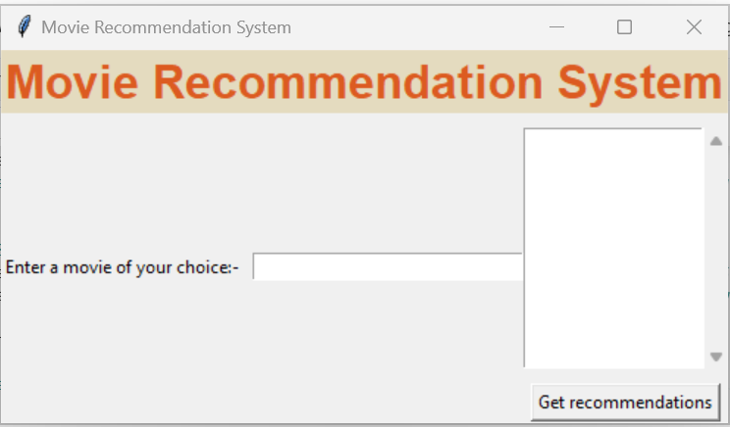
GRAPHICAL USER INTERFACE (GUI) INTEGRATION
Introduction:
Purpose of the Code: This code integrates the movie recommendation functionality into a graphical user interface (GUI). The recommend_movies function clears previous content, handles user input, and displays movie recommendations through visually appealing Matplotlib charts. The purpose is to enhance user experience and provide an intuitive platform for exploring movie suggestions.
Visualization:
Matplotlib for creating visualizations
Bar chart displaying cosine similarity percentages
Pie chart for the top 5 recommendations
Vertical scrollbars for both charts
User Interface:
Clearing and updating the Tkinter frame
Handling invalid inputs and displaying messages

Slide 16
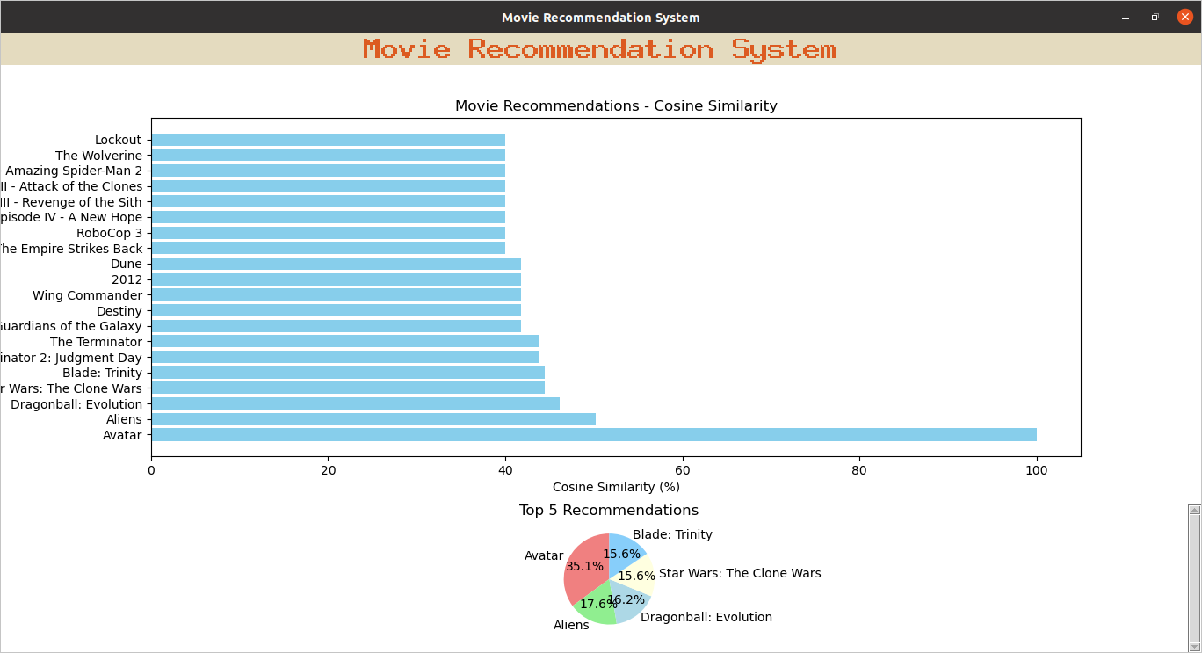

Slide 17
Thank you

